Slide 1
Kåre Rude Andersen
Be a Hero – Optimize SCOM and present your Services

Slide 2
Who am I
Kåre Rude Andersen - @KraCoretech
Consultant / Speaker / Trainer / Member of Microsoft SC Alliance Team
Coretech A/S | mail: kra@coretech.dk

Slide 3
Agenda
Introduction to Services
Ready Steady – GO!
Present SLO and SLA in a Dashboard
Bottlenecks – SCOM Performance
Whats New in R2
Use cases

Slide 4
Services Concept
ITEL/MOF Process
People, Process and IT
Service Alert Escalation
Service Owners (layer 1-2-3)
1/3 have a defined service plan, and less downtime

Slide 5
Services Concept
Clear Goal
Base Monitoring
What is ”Normal”
Marketing yourself – Do your colleagues know about the fantastic work you are doing?
Get the Control and Console
Find those SQL Report Servers installed on HP HW
Find the objects and the error
Security Services – Use the products (AEM/ACS/APM)
Service Catalog (CMDB – Service Manager)

Slide 6
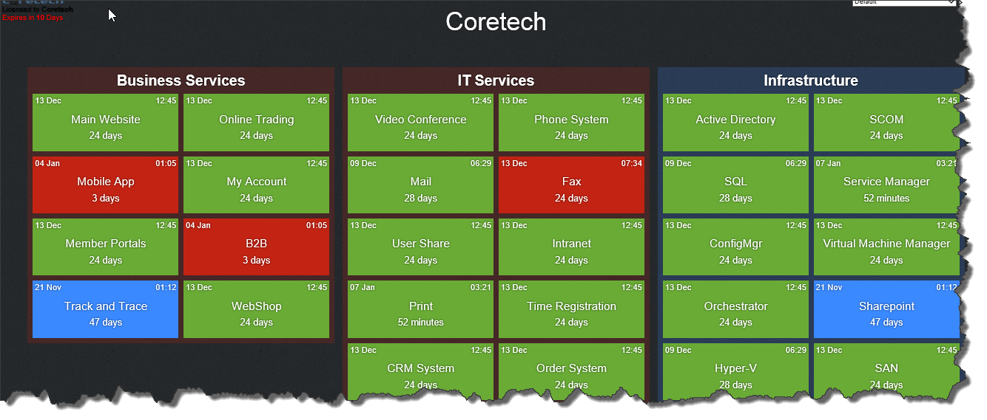
Ready, Steady - GO!
Define the Goal
Define Service Owners and let them in..
Define which dashboard your organization will see
Do a PoC, and Test
Built-in Dashboard
Visio Maps / Sharepoint
3. part solutions
http://coretech.dk/products/dashboard-scom/

Slide 7
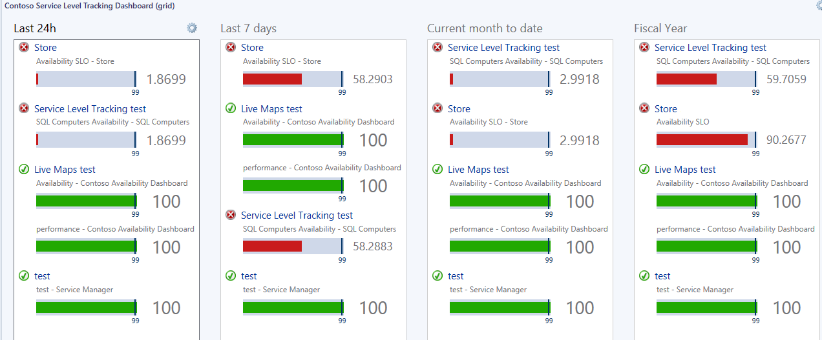
SLA Dashboard
Create DA’s or Groups in SCOM
Define your Services SLA and SLO
Create Rollup and Present

Slide 8
Demo
Create a Group
Put SLA on it
Present it in varios ways

Slide 9
Bottleneck
Where is it slow?
Identify the individual layers
What’s Normal???

Slide 10
Layer 1 - Database
Memory – Page Life Expectancy
SELECT cntr_value AS [Page Life Expectancy]
FROM sys.dm_os_performance_counters
WHERE [object_name] = N'SQLServer:Buffer Manager‘
AND counter_name = N'Page life expectancy' OPTION (RECOMPILE);

Slide 11
Layer 1 - Database
Disks – Database Performance against SAN, DAS
SELECT DB_NAME(fs.database_id) AS [Database Name], mf.physical_name, io_stall_read_ms, num_of_reads,
CAST(io_stall_read_ms/(1.0 + num_of_reads) AS NUMERIC(10,1)) AS [avg_read_stall_ms],io_stall_write_ms,
num_of_writes,CAST(io_stall_write_ms/(1.0+num_of_writes) AS NUMERIC(10,1)) AS [avg_write_stall_ms],
io_stall_read_ms + io_stall_write_ms AS [io_stalls], num_of_reads + num_of_writes AS [total_io],
CAST((io_stall_read_ms + io_stall_write_ms)/(1.0 + num_of_reads + num_of_writes) AS NUMERIC(10,1))
AS [avg_io_stall_ms]
FROM sys.dm_io_virtual_file_stats(null,null) AS fs
INNER JOIN sys.master_files AS mf
ON fs.database_id = mf.database_id
AND fs.[file_id] = mf.[file_id]
ORDER BY avg_io_stall_ms DESC OPTION (RECOMPILE);

Slide 12
Layer 1 – SQL – Why Wait?
WITH Waits AS
(SELECT wait_type, wait_time_ms / 1000. AS wait_time_s,
100. * wait_time_ms / SUM(wait_time_ms) OVER() AS pct,
ROW_NUMBER() OVER(ORDER BY wait_time_ms DESC) AS rn
FROM sys.dm_os_wait_stats
WHERE wait_type NOT IN ('CLR_SEMAPHORE','LAZYWRITER_SLEEP','RESOURCE_QUEUE','SLEEP_TASK',
'SLEEP_SYSTEMTASK','SQLTRACE_BUFFER_FLUSH','WAITFOR', 'LOGMGR_QUEUE','CHECKPOINT_QUEUE',
'REQUEST_FOR_DEADLOCK_SEARCH','XE_TIMER_EVENT','BROKER_TO_FLUSH','BROKER_TASK_STOP','CLR_MANUAL_EVENT',
'CLR_AUTO_EVENT','DISPATCHER_QUEUE_SEMAPHORE', 'FT_IFTS_SCHEDULER_IDLE_WAIT',
'XE_DISPATCHER_WAIT', 'XE_DISPATCHER_JOIN', 'SQLTRACE_INCREMENTAL_FLUSH_SLEEP',
'ONDEMAND_TASK_QUEUE', 'BROKER_EVENTHANDLER', 'SLEEP_BPOOL_FLUSH'))
SELECT W1.wait_type,
CAST(W1.wait_time_s AS DECIMAL(12, 2)) AS wait_time_s,
CAST(W1.pct AS DECIMAL(12, 2)) AS pct,
CAST(SUM(W2.pct) AS DECIMAL(12, 2)) AS running_pct
FROM Waits AS W1
INNER JOIN Waits AS W2
ON W2.rn <= W1.rn
GROUP BY W1.rn, W1.wait_type, W1.wait_time_s, W1.pct
HAVING SUM(W2.pct) - W1.pct < 99 OPTION (RECOMPILE)

Slide 13
SQL – Database Performance
SQL Standard settings
MDOP
Stripe the Database (Tempdb and OpsMgr)
Max Memory
Truncate log on Checkpoint
Always On
http://blogs.technet.com/b/manageabilityguys/archive/2013/09/20/quot-mdoping-quot-your-scom-console-performance-with-some-simple-sql-tips.aspx

Slide 14
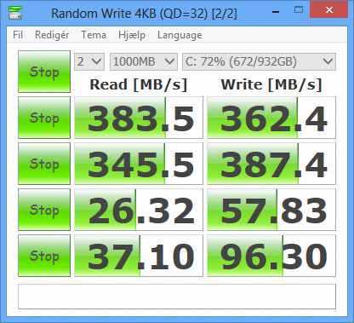
Layer 2 – Management Server
Disk, Disk, Disk, Disk, Disk
Disk, Disk, Disk, Disk, Disk
Disk, Disk, Disk, Disk, Disk
CrystalDiskMark

Slide 15
Layer 2 – Management Server
Memory
Installed connectors on the Management Server
Distribute the Workload
Resource pools
GW servers if round time threshold > 20 ms
Processer:
HKLM\SOFTWARE\Microsoft\Microsoft Operations Manager\3.0\GroupCalcPollingIntervalMilliseconds

Slide 16
Layer 3 – Agent, Linux, Network
Management Pack Design – discoveries
Scripts, Powershell timeout
MaximumQueuesizeKB
Netværk and Linux

Slide 17
Demo
SQL Server Performance

Slide 18
News in 2012 R2
Advisor
System Center Management Pack for VMM Fabric Dashboard 2012 R2
IPv6 ifm Network Discovery
Microsoft Monitoring Agent
DevOps
Java APM (Tomcat, JDK, GenericServlets, Struts, Struts2, Axis)
Dashboard Performance

Slide 19
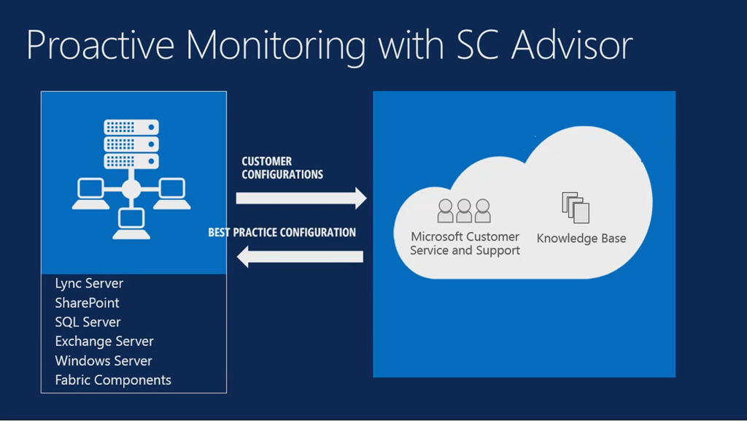
Advisor

Slide 20
Demo
Advisor

Slide 21
SDK
Create Groups in SCOM
Define your Services SLA and SLO
Create Rollup and Present

Slide 22
SDK – Web Services
param($ServiceNowUrl,$AlertXML)
$ErrorActionPreference = "stop"
Import-Module OperationsManager
$Alert = Get-SCOMAlert -Id $AlertXML.AlertId
#login SOAP
$username = "MIDserver3M"
$password = "password" | ConvertTo-SecureString -asPlainText -Force
$credential = New-Object System.Management.Automation.PSCredential($username,$password)
$url = 'https://MMMdev.service-now.com/u_scom.do?WSDL'
$sn = New-WebServiceProxy -uri $url -Credential $credential
#get autogenerated namespace
$type = $sn.GetType().Namespace
$insert = new-object ($type + '.insert')
#Insert a new record with these values
$insert.acknowledgesync = ""
$insert.category = $Alert.Category
$insert.customfield1 = $Alert.Custom1
$insert.customfield2 = $Alert.Custom2
$insert.description = $Alert.AlertDescription
$insert.id = $Alert.AlertId
$insert.managementgroup = $Alert.managementgroup #TODO
$insert.monitoringobjectfullname = $Alert.ManagedEntityFullName
$insert.monitoringobjectid = $Alert.ManagedEntity
$insert.monitoringobjectpath = $Alert.ManagedEntityPath
$insert.name = $Alert.AlertName
$insert.netbioscomputername = $Alert.netbioscomputername #TODO
$insert.owner = $Alert.AlertOwner
$insert.parameters = $Alert.AlertParams
$insert.principalname = $Alert.principalname #TODO
$insert.priority = $Alert.priority
$insert.repeatcount = $Alert.RepeatCount
$insert.resolutionstate = $Alert.ResolutionStateName
$insert.severity = $Alert.severity
$insert.sitename = $Alert.sitename #TODO
$insert.timeraised = $Alert.TimeRaised
$insert.timeresolution_telastmodified = $Alert.TimeResolutionStateLastModified
$result = $sn.insert($insert)
$Alert | Set-SCOMAlert -TicketId $result.display_value

Slide 23
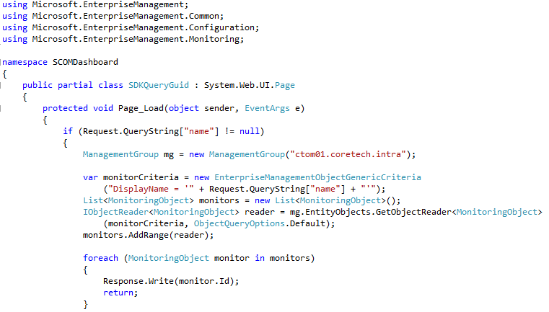
SDK – Get the Guids from Name

Slide 24
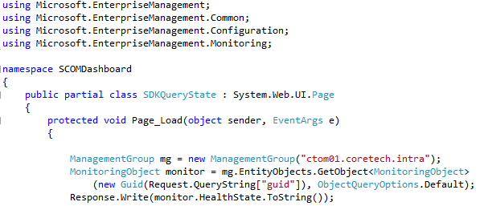
SDK – Get HealthState

Slide 25
Use-Cases
Automatic Maintenance Mode
Alert Robot
Resend Alert again

Slide 26
Automatic Maintenance Mode
Use either:
http://www.systemcentercentral.com/opsmgr-2012-group-maintenance-mode-via-powershell-the-way-it-should-be
or
http://gallery.technet.microsoft.com/scriptcenter/Put-OM2012-Computer-Group-43902672
Next slide

Slide 27
Automatic Maintenance Mode
Create a Command Channel that runs a script like this:

Slide 28
Alert Robot
Import-Module OperationsManager
$Alerts = get-scomalert -ResolutionState 0
if ($Alerts)
{
foreach($Alert in $Alerts)
{
$newState = $null
switch -wildcard ($Alert.Description)
{
"*Active directory*" { $newState = 10 }
"*DNS*" { $newState = 30 }
"*Cisco*" { $newState = 250}
}
switch -wildcard ($Alert.Name)
{
"ACME.Monitor.Event.Dummy.100" { $newState = 249 }
"Another Alert Text" { $newState = 10 }
}
if($newState -ne $null)
{
$Alert.ResolutionState = $newState
$Alert.Update(“Resolution State changed automatically by the QueueManager Robot”)
}
}
}

Slide 29
Resend Alert again, again a…
$oldAlerts = Get-SCOMAlert | Where-Object {($_.LastModified -ge [DateTime]::Now.AddHours(-4)) -and ($_.ResolutionState -eq 0)}
ForEach($alert in $oldAlerts)
{
$alert.Update("")
}

Slide 30
Summary
Present your Services
Find the bottlenecks
Implement Automation

Slide 31
Please evaluate the session before you leave ☺

